Slide 1




Andrew Lounsbury Joshua Aldridge Kirill Zavalin Mada Subaiti Seth Beverley
Investigating the Relationships between COVID-19 and Various Factors

Slide 2
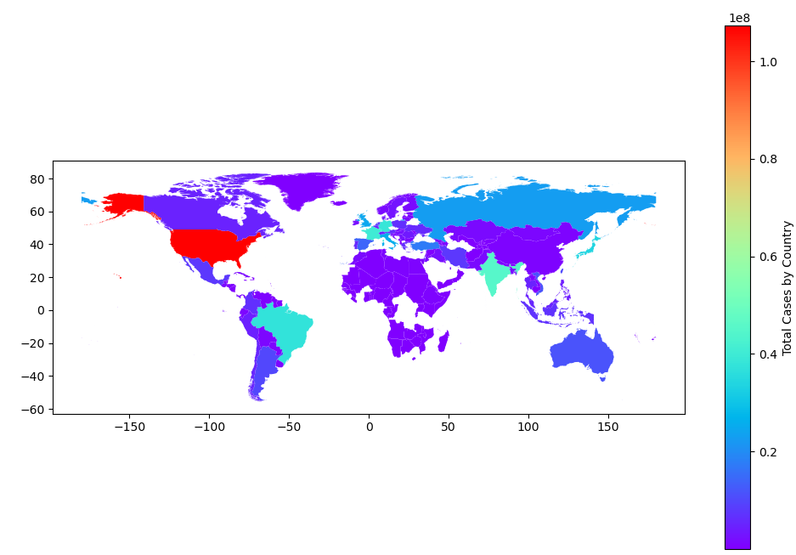
Introduction
Objective
Distinguish the strongest correlations to COVID-19 infection and significant complications rates by exploring the correlations between COVID-19 and multiple different factors.
Method
Analyzing relevant data and visualizing the findings using graphs and mapping tools, we aim to gain insights into how various factors may impact the spread and outcomes of COVID-19.
Total Covid Cases
44% Of world population
An estimated 3.8 billion total COVID-19 infections and reinfections occurred, with about 3.4 billion people infected at least once

Slide 3
Hypothesis
1. The incidence of COVID-19 cases and deaths is greater in countries with lower vaccination rates
2. Countries with higher tourist traffic experience higher COVID-19 infection rates in 2020.
3. Population density and infection rates are correlated.
4. Countries with notoriously high COVID-19 cases have stricter and longer lockdown measures

Slide 4
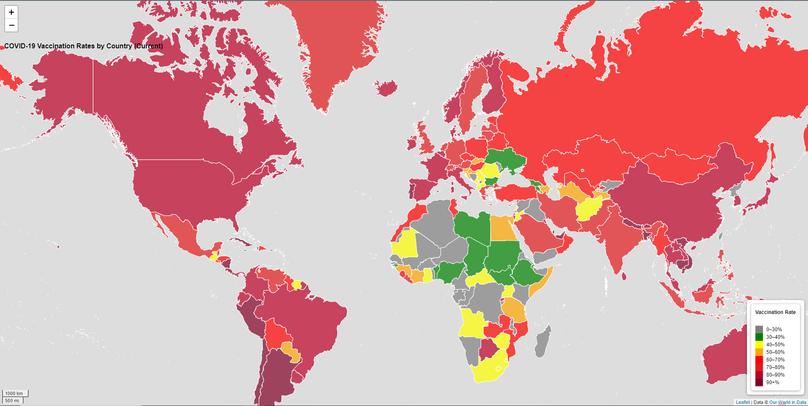
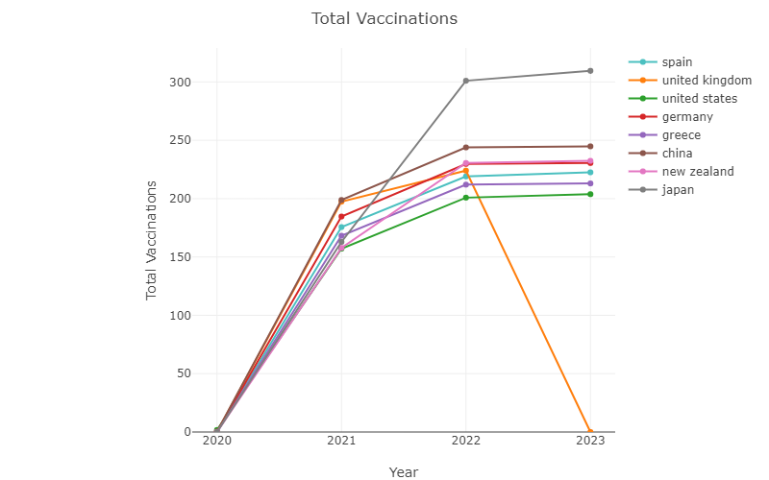
Vaccination Rates by Country
Notes:
Africa has the lowest vaccination rate of any continent, with just 37.2 percent of the population receiving at least one dose of a vaccine, compared to 82.3 percent in Latin America.

Slide 5

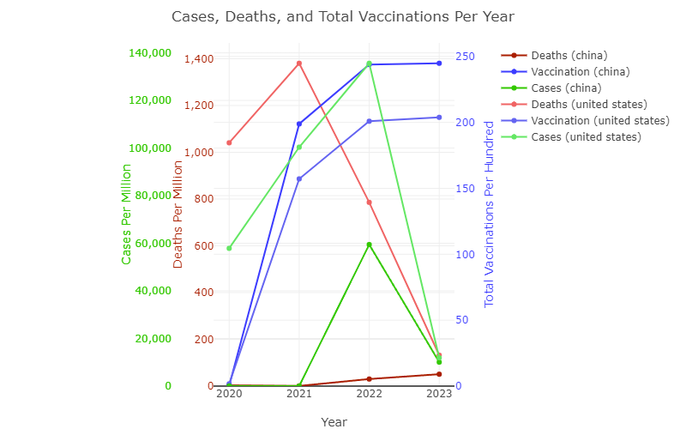
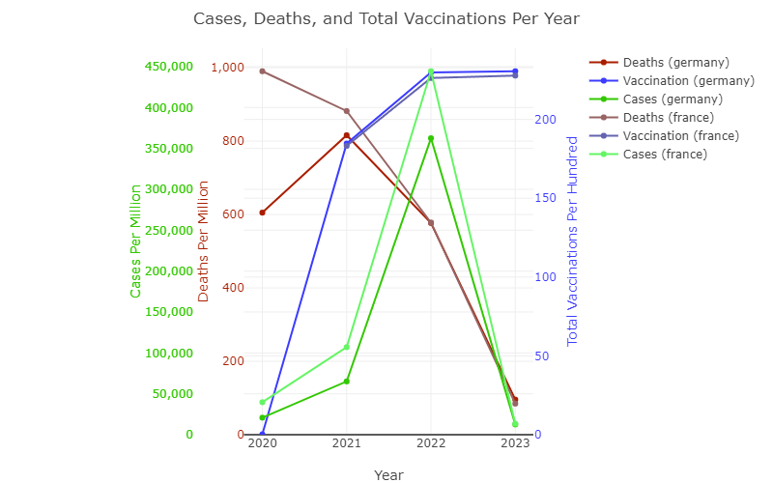
Cases, Death and Total Vaccinations Per Year
Vaccination rates around the world have stagnated in recent months, with public demand dropping even as vaccine supply has become more abundant.
COVID-19 cases among vaccinated individuals is indeed lower compared to unvaccinated individuals in the same region.
The fatality rate is higher among those who are not vaccinated

Slide 6
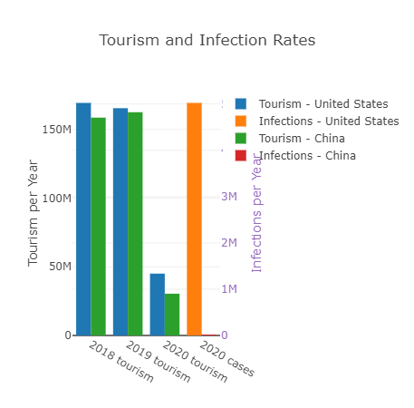
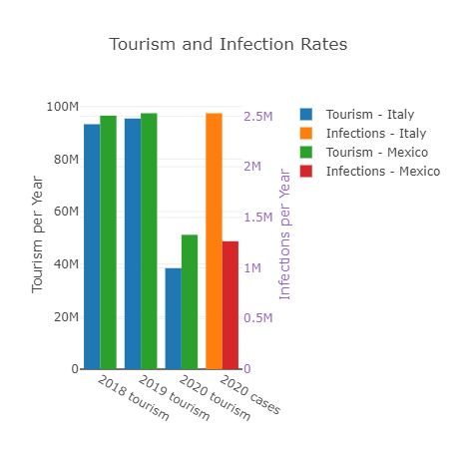
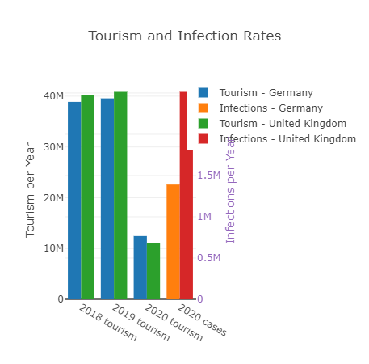
Correlation Between Global Travel and Infection Rates
Positive and significant association between the past records of international tourism and the current cumulated numbers of confirmed cases of COVID-19.
The Higher the tourism and presence of international travel the higher cases there were

Slide 7

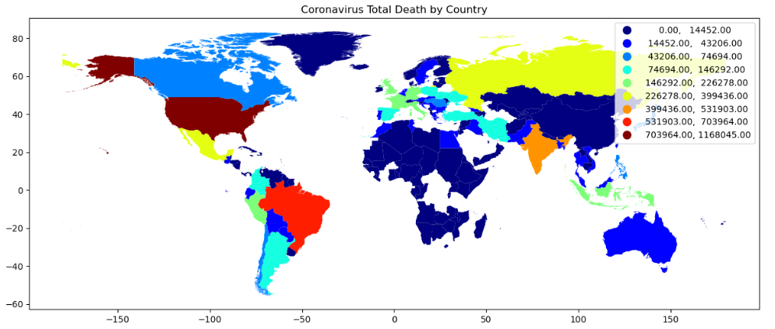



Conclusion
In conclusion, our project found that the incidence of COVID-19 deaths is lower in countries with higher vaccination rates
Furthermore, our analysis revealed that there are other factors beyond vaccination status that can impact the spread and outcomes of COVID-19.
These include demographic factors such as tourism, population density, and government intervention in the form of lockdown measures

